Slide 1
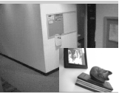
Picture in Picture
Ali Hussien Ahmed
Sec 2
IT Dept.

Slide 2
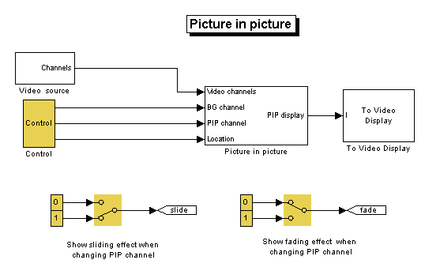

Slide 3

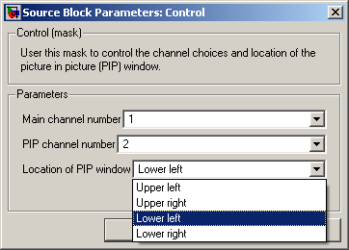
Control
How To Report Location i.e. Convert string Values to Coordinates ?

Slide 4
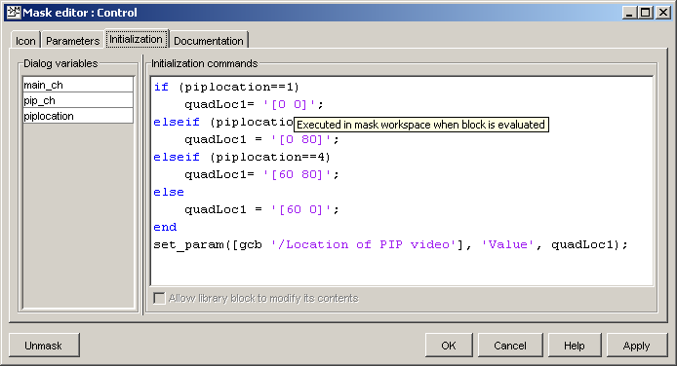
By Editing Mask ,looking in initialization
Get the pathname of the current block (gcb) and set the “QuadLoc1” Variable
set_param is used to Set block parameter “The location of PIP Video”

Slide 5

PIP
Input
  The 3 video channels
  The background video channel number
  PIP video channel number
  And the coordinates of the final PIP Position
Output
  The Mixed Video To be Displayed

Slide 6
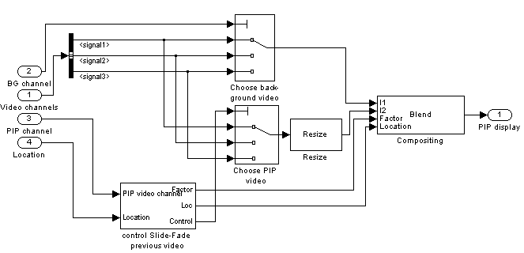
What’s inside?

Slide 7


Two Multi-port Switch
They take as input the three video channels and a selector number taken from the Control Dialog

Slide 8

Resize
Whatever The selected PIP Video it must be resized to fit within the ¼ of the BG Video

Slide 9

Compositing Video
Both PIP Video And BG Video Are composted.
The PIP Opacity is an input Port that
  1→0 When PIP changed and Removed.
  0→1 When new PIP is Inserted
The PIP Location is Taken in Runtime it is not constant it increased or deceased to reach it final Poisition!

Slide 10
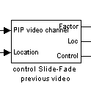
The Big Problem!
Input
  Selected PIP Video Channel.
  Selected PIP Coordinates.
Output
  PIP Opacity Factor (Descending-Ascending)
  The variable Location To Achieve the sliding PIP Affect.
  Control, it is the PIP Video Pointer or number ,it is not applied to the switch directly because we need to delay the new PIP Channel selection for a while(z^-32 ) until the fading and sliding affects is achieved.

Slide 11
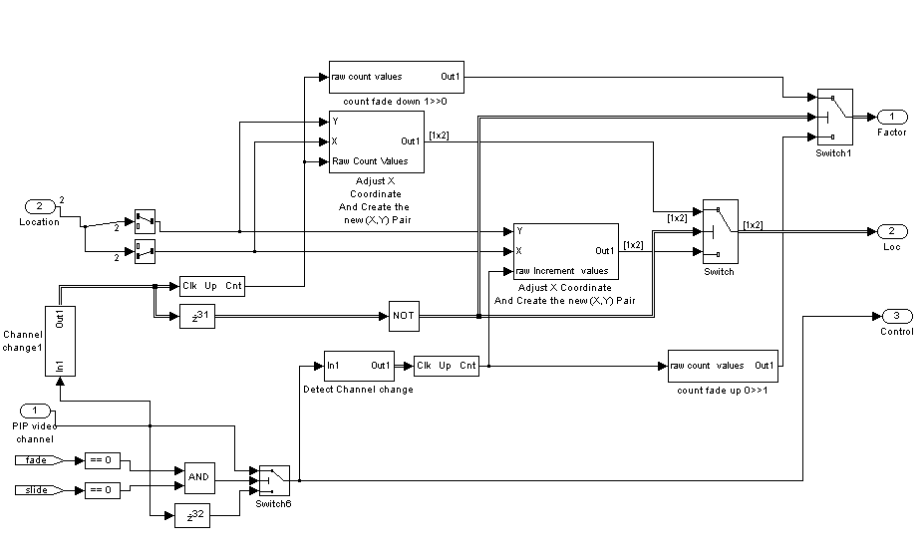
What’s inside?
Back

Slide 12
Sliding

Slide 13

Split Coordinates
They both take (x,y)
Pair One of them selects X other selects Y.
We need it, to get X to be incremented or decremented to achieve Slide effect.
Also to reset PIP Location to reflect the new selected Y value of location .

Slide 14
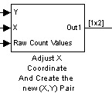
Input
  Y to be concatenated with X to get true coordinate.
  X to be incremented.
  Count values to be multiplied by 5 the increment value by X.
Output
  The new (X,Y) Pair with value of X increases this indicates the gradual removal (Slide!) of the PIP Video

Slide 15
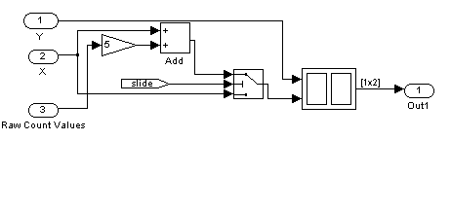
Inside!!

Slide 16
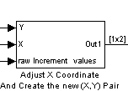
Input
  X to be concatenated with Y to get true coordinate.
  X+(155-5X) decremented.
  It is not 160-the width of the video-because the initial value of x approaches to 5.
  Count values to be multiplied by 5 the increment value by old X.
Output
  The new (X,Y) Pair with value of X decreases this indicates the entrance of the PIP

Slide 17
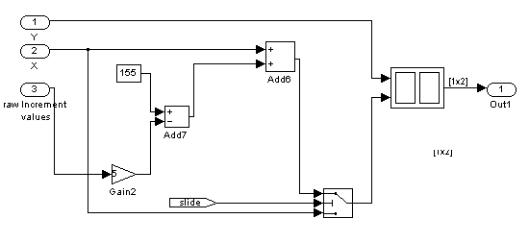
Inside!!

Slide 18
Enabled Counters
Two counter (0→31)exist, that both of them produces raw count values to both the fading and the sliding coefficients.
A “Gain” is used after count to adjust the increment or decrement of fade or slide coefficient values.
There are 32 level of fade.
PIP is slide out or in in 32 step.
They are enabled to count if user changes the PIP video Channel Number for the Control Block

Slide 19

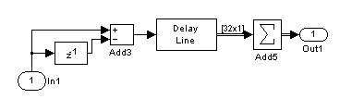
How to detect Channel Change
Hold the old PIP channel choice
Subtracting it from the new choice
Delay Line of size 32 is used so that counter still enabled to count 32 times ,to produce 32 distinct value of either opacity or X Position
The summation still producing the same non Zero value(32 times) ( result of subtraction) to each change in the PIP video Channel so that the fading or slide effect can take action.
Inside Block …

Slide 20
Fading

Slide 21

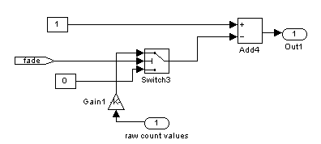
Decrease Opacity
This block is used to produce the fade coefficients in a decreased order so that the old PIP video opacity decreased to finally be invisible ,0%.
Inside Block …

Slide 22

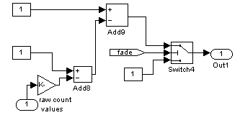
Increase Opacity
This block is used to produce the fade coefficients in an increasing order so that the new PIP video opacity increases to be finally be visible 100%.
Inside Block …

Slide 23

Why?
Taking the output of channel change detector then delay it by 32 so that the decrease of effects of the old PIP video Channel takes action.
Then invert it and use the inverted value to select the increasing of effects (Slide, fade) to show the new PIP Video.
After the Delay line finishes then the output will be zero and will be inverted to enable the effects decrease if a change in the PIP Channel Detected

Slide 24
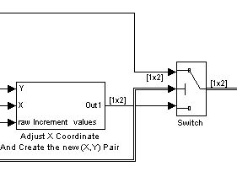
Sliding
Dec-Sliding Effect - old video
Inc-Sliding Effect – new video
Location-
To the Blend Block
Selector
Full View

Slide 25
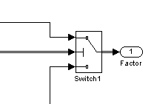
Fading
Dec-Opacity Effect - old video
Selector
Inc-Opacity Effect – new video
Full View

Slide 26
PIP Channel Control
If both slide and fade parameters are zeros then there is no need to wait for those effects to be done.
just report the selector of the new selected PIP video channel directly then select and report the blend by the PIP video.
If one of them is activated we don’t report change immediately ,we must wait for the selected effect to be done.

Slide 27
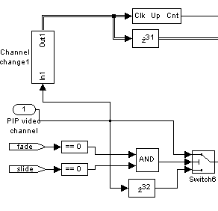
Control

Slide 28
END

